Slide 1

Mindful Leadership
The Key to Sustainable Success

Slide 2

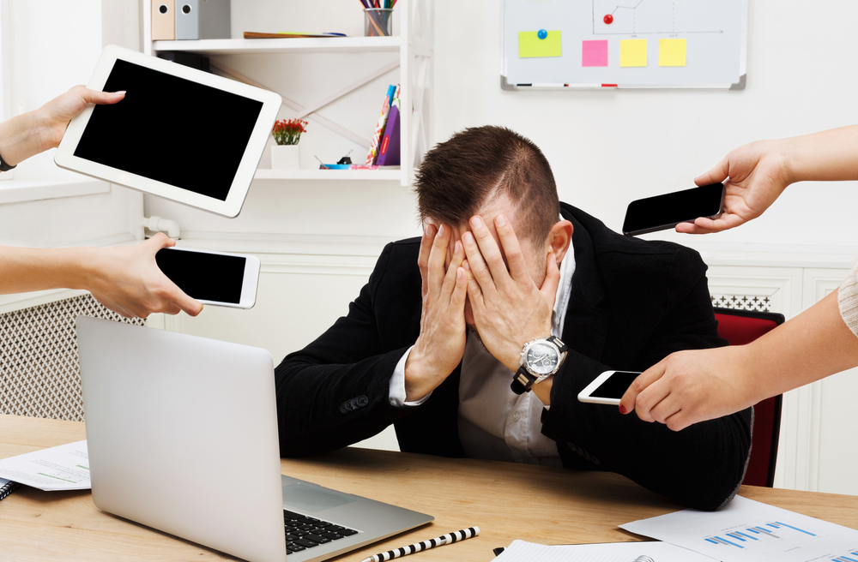
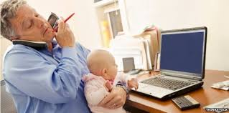
OUR WORLD IS INCREASINGLY COMPLEX

Slide 3
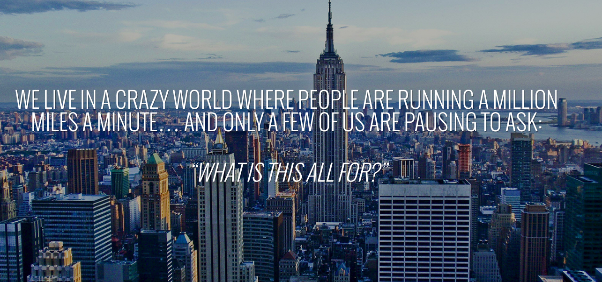

OUR WORLD IS INCREASINGLY COMPLEX

Slide 4
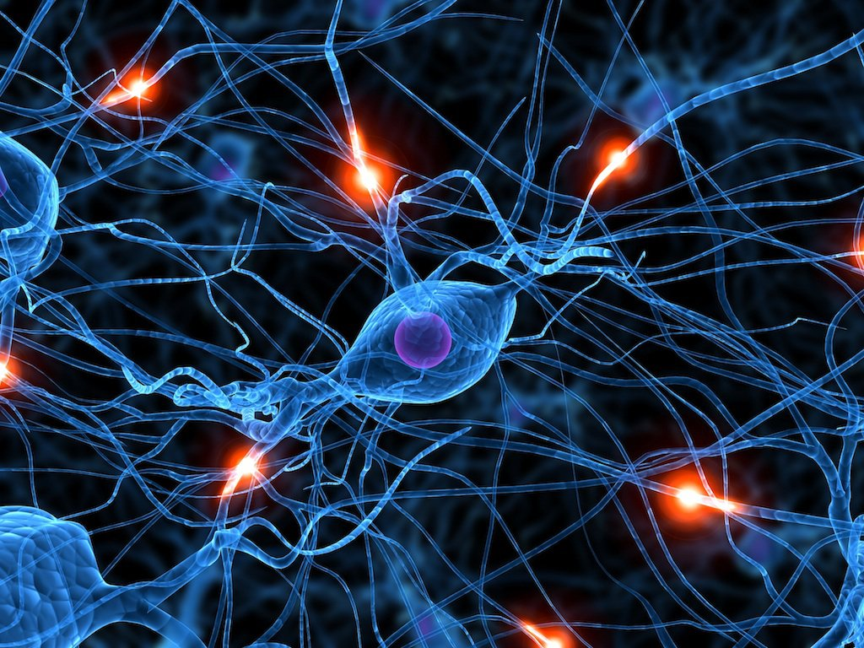
NEUROPLASTICITY
What we think, do and pay attention to changes the structure and function of our brains

Slide 5

INCREASE IN GRAY MATTER
Source: 2011 Hölzel, et all.

Slide 6

REDUCTION IN THE AMYGDALA
Source: 2011 Hölzel, et all.

Slide 7
E + R = O

Slide 8
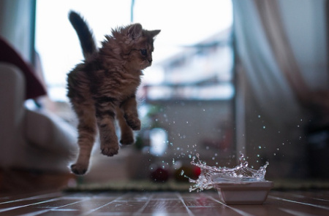
“Between stimulus and response there is a space.
In that space is our power to choose our response.
In our response lies our growth and our freedom.”

Slide 9

“Everything can be taken from a man but one thing: the last of the human freedoms – to choose one’s attitude in any given set of circumstances, to choose one’s own way.”
- Viktor E. Frankl, Man’s Search For Meaning

Slide 10
FROM COMPLAINT TO COMMITMENT
Person 1: Choose a situation at work that is REALLY frustrating you
Person 1: Tell your partner about the situation and really let it all out
Person 2: Listen mindfully and encourage your partner, but let them do the talking

Slide 11
FROM COMPLAINT TO COMMITMENT
Person 1: Ask yourself, how am I contributing to this? Hmmmmmmm...
Person 2: Listen mindfully

Slide 12
FROM COMPLAINT TO COMMITMENT
Person 1: Ask yourself, what is it I really want?
Person 2: Listen mindfully

Slide 13
FROM COMPLAINT TO COMMITMENT
Person 1: What am I willing to do to get what I want?
Person 2: Listen mindfully

Slide 14

FROM COMPLAINT TO COMMITMENT
Person 1: Write down an action step to take responsibility for this in the next week

Slide 15
SWITCH ROLES
(Same partner)

Slide 16
FROM COMPLAINT TO COMMITMENT
Person 2: Choose a situation at work that is REALLY frustrating you
Person 2: Tell your partner about the situation and really let it all out
Person 1: Listen mindfully and encourage your partner, but let them do the talking

Slide 17
FROM COMPLAINT TO COMMITMENT
Person 2: Ask yourself, how am I contributing to this? Hmmmmmmm...
Person 1: Listen mindfully

Slide 18
FROM COMPLAINT TO COMMITMENT
Person 2: Ask yourself, what is it I really want?
Person 1: Listen mindfully

Slide 19
FROM COMPLAINT TO COMMITMENT
Person 2: What am I willing to do to get what I want?
Person 1: Listen mindfully

Slide 20
FROM COMPLAINT TO COMMITMENT
Person 2: Write down an action step to take responsibility for this in the next week

Slide 21
GROUP SHARE
What did you notice or experience?
Anytime you find yourself complaining or resentful, take yourself through this process:
1. Summarize your complaint in one sentence
2. “Hmmm, how am I contributing to this?”
3. “Hmmm, what is it I REALLY want?” (that’s in my control and can be initiated by me)
4. “What am I willing to do to get what I want?”

Slide 22
TAKING 100% RESPONSIBILITY
FOR TIME

Slide 23
BELIEFS THAT KEEP US A VICTIM OF TIME
Busy as a status symbol

Slide 24
BELIEFS THAT KEEP US A VICTIM OF TIME
Busy as a status symbol
Multi-tasking is effective

Slide 25
100% RESPONSIBILITY FOR TIME
Busy as a status symbol
  Notice when you’re bragging about being “busy”
  Simplify your To Do list
    Taking something off your list entirely counts!

Slide 26
100% RESPONSIBILITY FOR TIME
Busy as a status symbol
  Simplify your to do list
Multi-tasking is effective
  Power Hour

Slide 27
Write down your 1-3 to do
Schedule your power hour

Slide 28
MINDFUL MOMENTS @ WORK
When you pick up your phone
or see a text, take a breath
Tune into your five senses
Start meetings by having everyone stand, stretch and take 3 deep breaths
Drink a glass of water and feel it nourish your body

Slide 29
MINDFUL MOMENTS @ WORK
When you pick up your phone
or see a text, take a breath
Tune into your five senses
Start meetings by having everyone stand, stretch and take 3 deep breaths
Drink a glass of water and feel it nourish your body
Take a self-compassion break
Send loving kindness (may you be well, may you be happy, may you live in peace) to others in meetings or when you receive a text or email
Create mindfulness calendar reminders
Take a mindful walk to the restroom

Slide 30
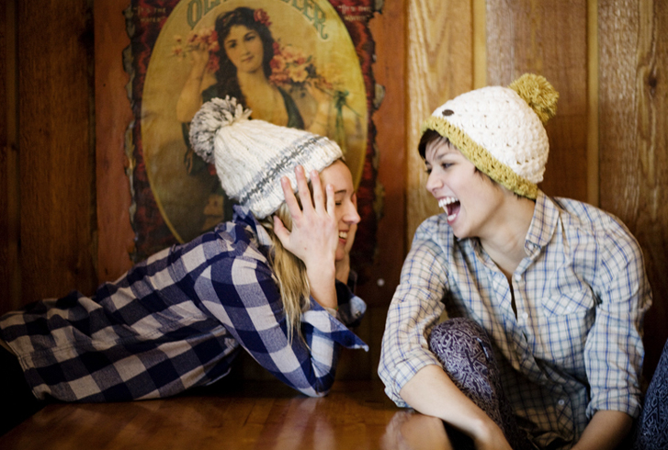
APPRECIATION:
The Key to Thriving at Work

Slide 31
WRAP UP
Take turns appreciating your partner

Slide 32
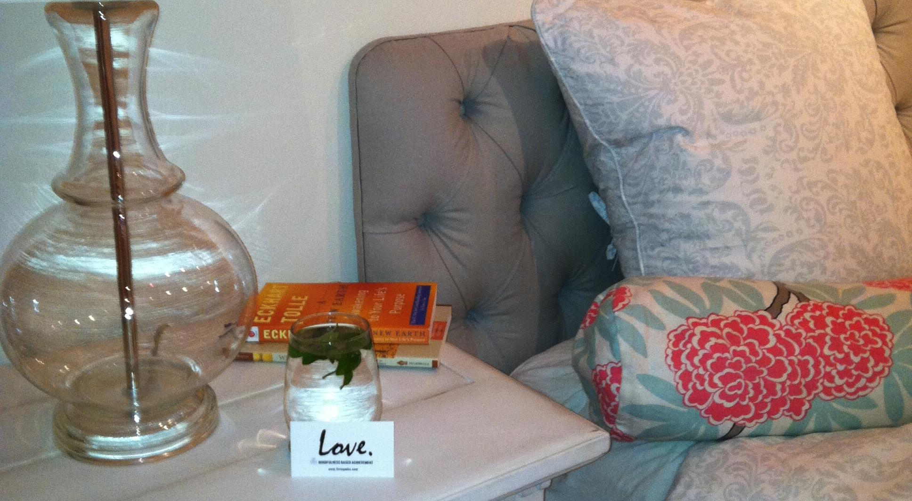
RECOMMENDED SUCCESS RITUAL

Slide 33
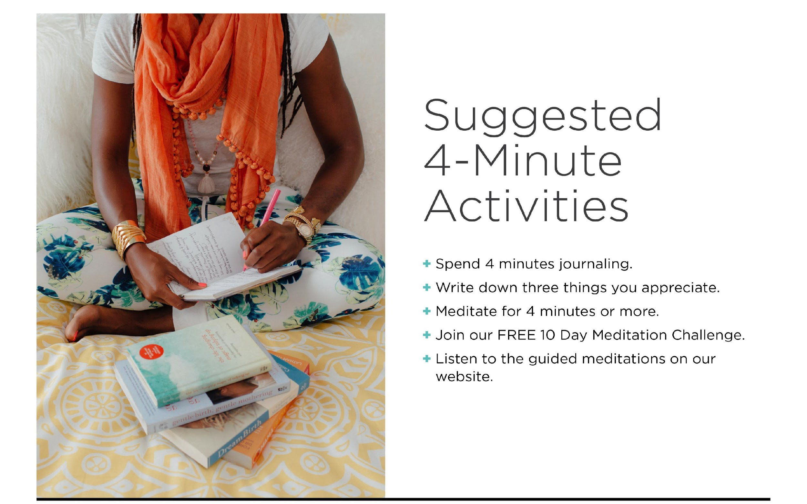

Slide 34
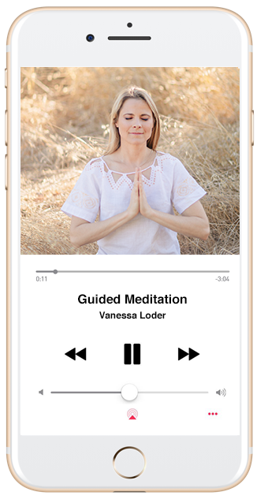
Get Short, Guided Meditations for 30 days (FREE!)
www.vanessaloder.com/30-day
Join Vanessa’s 30 Day Meditation Challenge

Slide 35

THANK YOU!!!
It’s been a pleasure.
You’ve GOT this!

